Slide 1
Urban Water Management
Sustainable Cities Course
Accra Beach Hotel, Bridgetown, Barbados
11-14 August, 2015

Slide 2
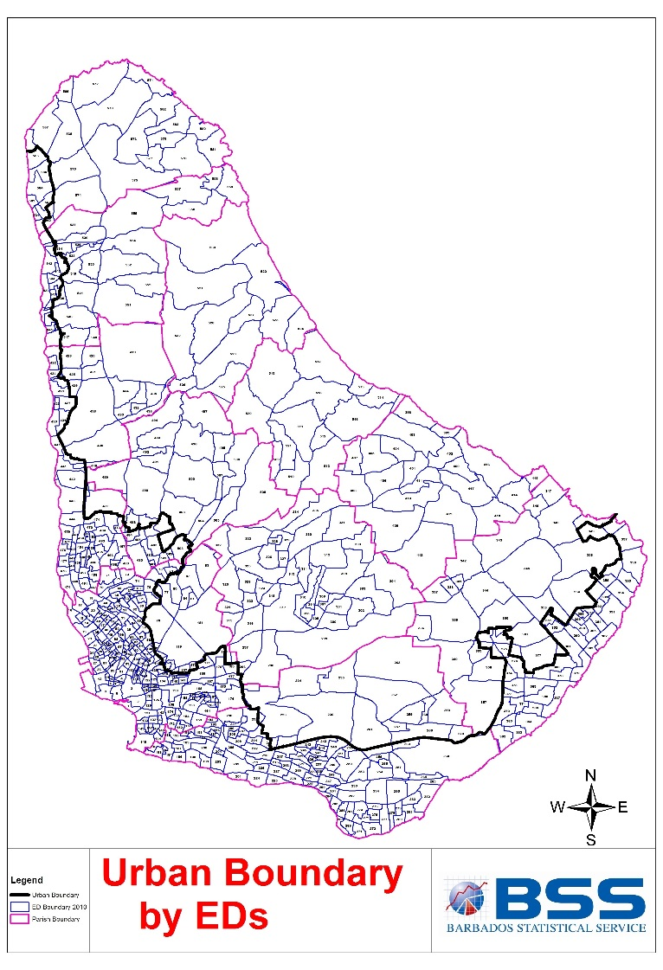
The ‘Urban’ Context of Barbados
No discrete urban centre
Comprehensive network infrastructure and wide availability of services
PDP (2003) defines an Urban Corridor (UC)
Coastal location
Water and sewerage services play catch-up

Slide 3
Urban Demographics: Overview
Population is ageing (under-15s fell from 24.1% in 1990 to 19.7% in 2010)
Suburbanisation rather than Urbanisation:
  UC Share of Population fell from 67.9% in 2000 to 66.3% in 2010
  UC Share of Occupied Dwellings in the UC fell from 69.7% in 2000 to 67.8%
  Between 2005 and 2010 a net out-movement from ‘urban’ parishes; St. Michael (-2,505), St. Philip (+1,081)
Notes:
Managing rapid urbanisation
Population Trends (1990 to 2010)
Suburbanisation: Barbados is characterised more by suburbanisation than urbanisation. In 2010 the population in the Urban Corridor (UC) comprised 66.3% of the total population, down from 67.9% in 2000. In addition, 67.8% of occupied dwellings were in the UC in 2010 as opposed to 69.7% in 2000.
Ageing Population: In 1990 the proportion of under-15s was 24.1%, falling to 21.5% in 2000, and 19.7% in 2010 (Barbados Statistical Service, 2013).
Housing Stock Growth outside of the UC: The total housing stock grew by 11.4% over the period 1990 to 2000, but only by 2.8% between 2000 and 2010. The majority of growth in the housing stock was outside of the UC.
Out-migration from Urban Parishes: Net movement out of the most urbanised parishes (St. Michael, Christ Church, St. James, St. Peter) resulted in a population decline in these areas of nearly 1,500 persons. St. Michael had the highest net out-movement (2,505) and St. Philip had the net highest in-movement (1,081).
Public Policy Responses
Urban Development Commission (UDC): Established in 1997 to: ‘…provide services and programmes that would assist in the eradication of poverty and to enhance sustainable quality of life and high standards of living for the urban population’.
Rural Development Commission (RDC): established in 1996 to: ‘…inter alia provide for the improvement of social amenities, assist small farmers, and establish and develop cottage industries in rural areas’ (Government of Barbados, 1997, p. 3).
See http://www.udc.gov.bb/index.php?option=com_content&view=article&id=13&Itemid=2 [Accessed 13th May 2015]

Slide 4
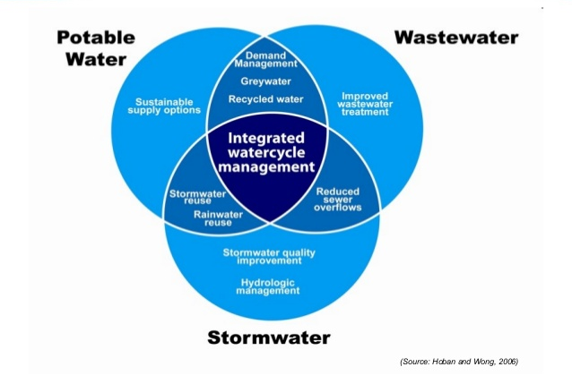
Components of Urban Water

Slide 5
Source: Vairavamoorthy & Brikke

Slide 6
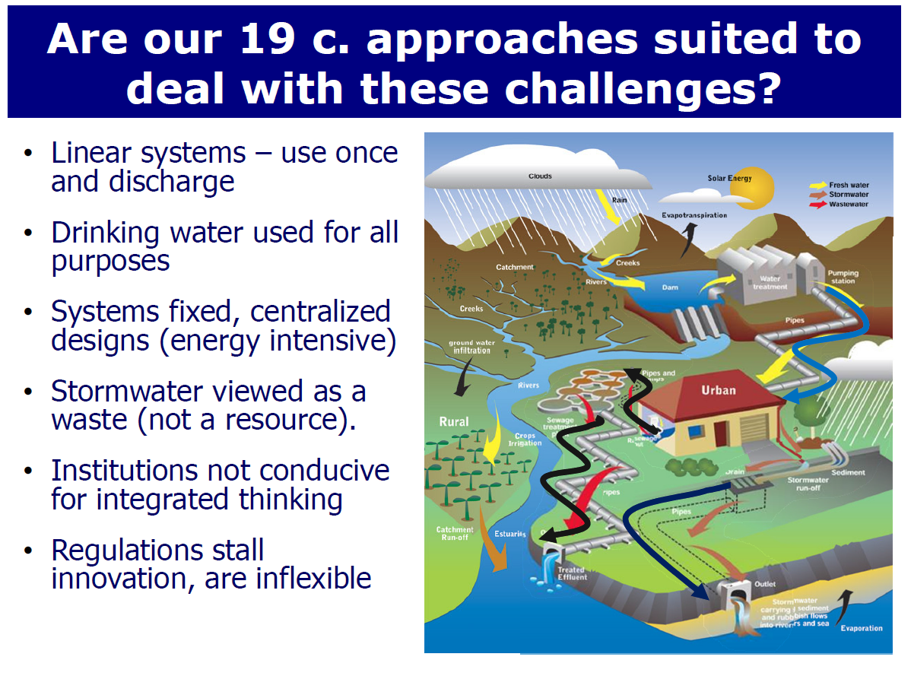
Source: Vairavamoorthy & Brikke

Slide 7
Source: Vairavamoorthy & Brikke

Slide 8
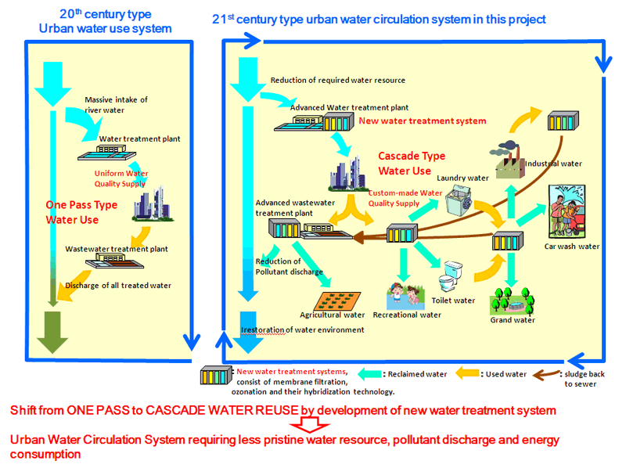
Source: Tanaka, 2010

Slide 9
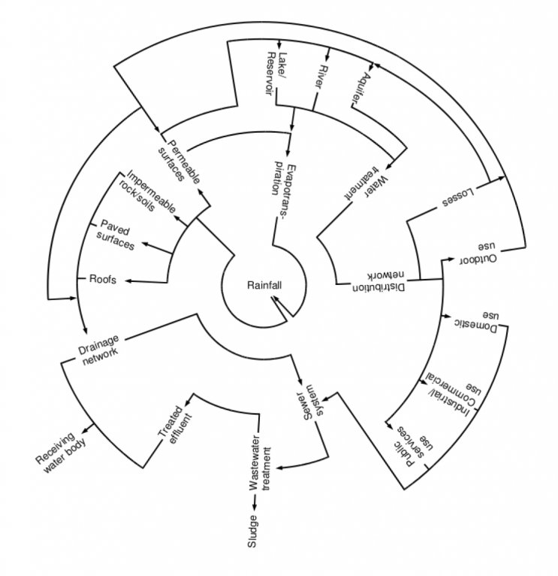
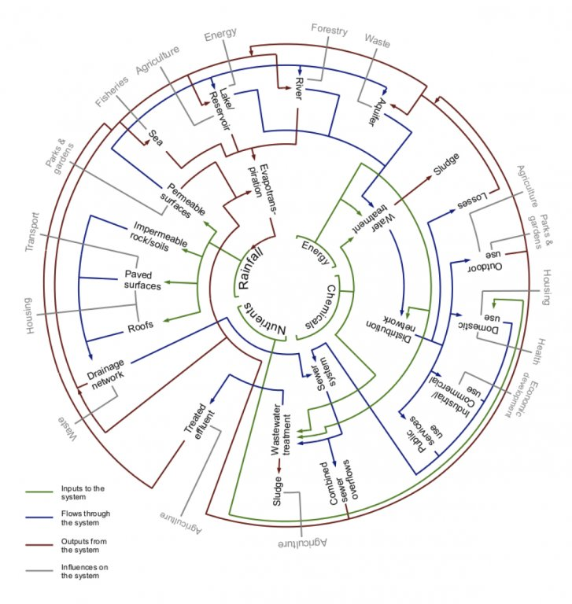
Water in the Urban Environment
It’s not so simple is it….

Slide 10
So what are the water related challenges facing urban areas in the Caribbean?
Let’s have your thoughts…….

Slide 11
Water Management
Water security
  Quantity
  Quality
  Accessibility
  Affordability
    Who should pay
    How should we pay
    How much should we pay
Water supply
  Resource limitations
  Service operation & management
Wastewater
  Re-engineering
  Resource recovery
Water related hazards
  Role of town planning

Slide 12
Climate related hazard impacts on urban environments

Slide 13
Goals and levels of management

Slide 14
The City as an organism

Slide 15
An Integrated Approach

Slide 16
Recent thinking in IUWM
Response to changing circumstances
  Manufactured hazards
  Changing perceptions & expectations
  Responding to complexity
  Finance & economics

Slide 17
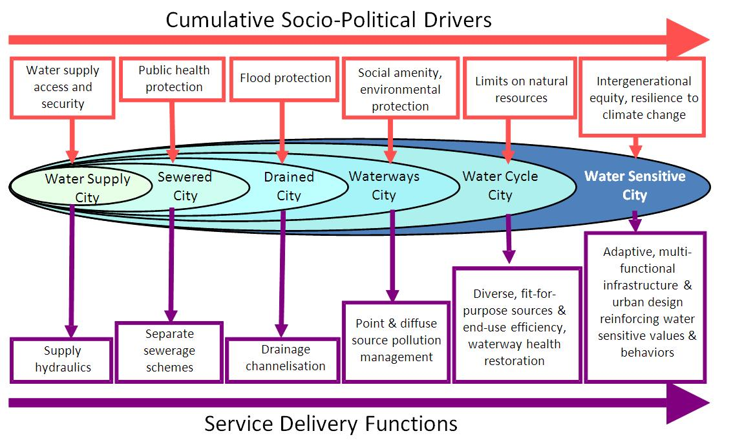
Source: Wong and Brown, 2009

Slide 18
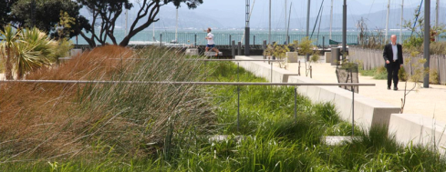
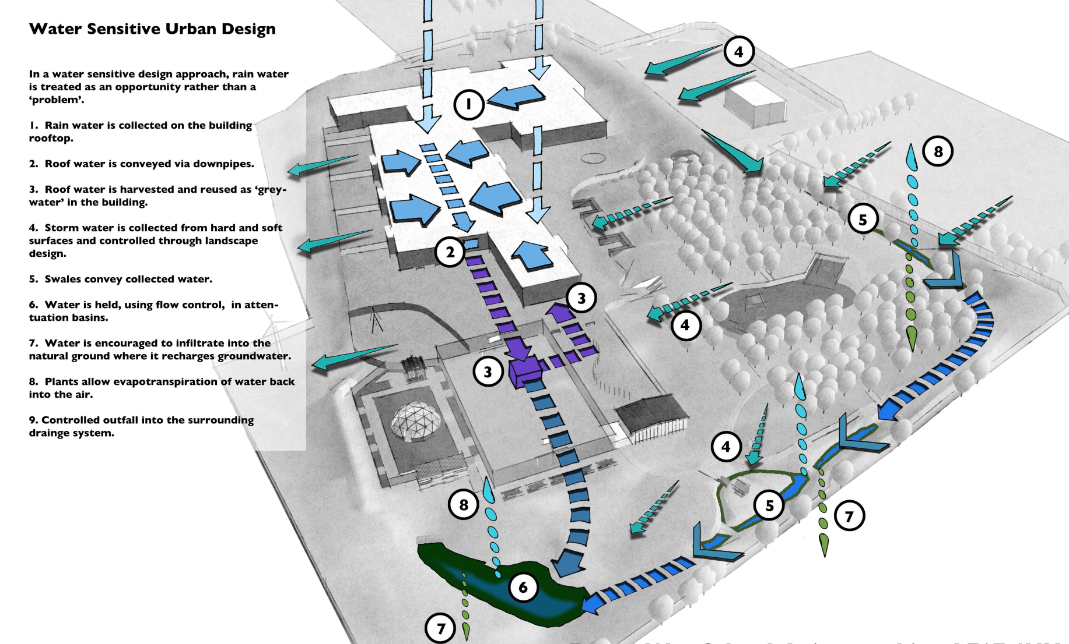
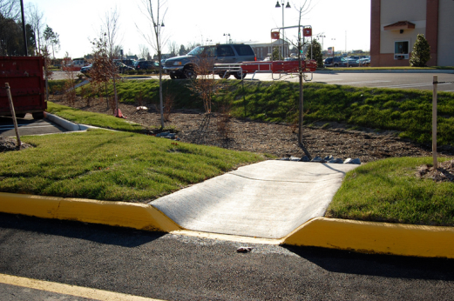
Water Sensitive Urban Design Approaches

Slide 19
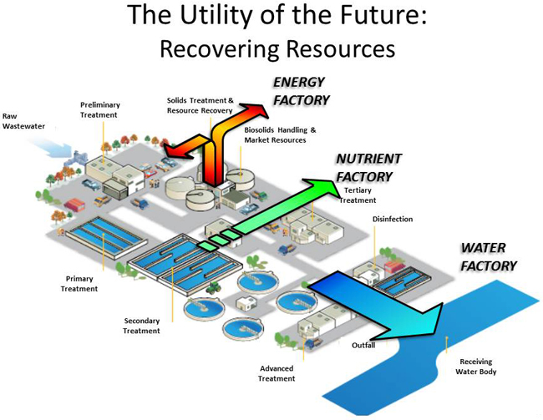

Slide 20
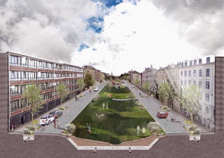
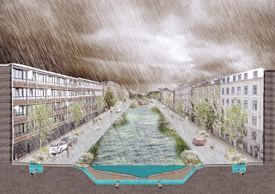
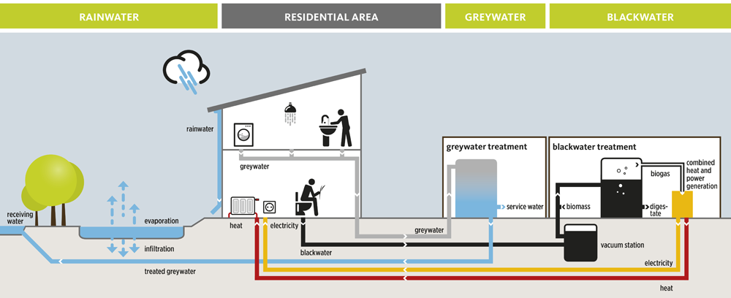
Some initiatives
Copenhagen
Stormwater management
Hamburg-Harburg
Wastewater reuse

Slide 21
Are we missing a trick?
How could we do things better?
Could we ‘close’ the water cycle?

Slide 22
Use of ICT in Water Management

Slide 23
ICT – Where could we apply it in the Water Sector in Barbados?
What applications can you suggest
Who would do it
Why would it be applied

Slide 24
Source: Vairavamoorthy & Brikke

Slide 25
Source: Vairavamoorthy & Brikke

